Slide 1
3. Synthesis Algorithms
Synthesis of 4D motion effects for classes CF, CS, and V.
These classes cover almost all effects of 4D rides, and about 36% of motion effects for regular 4D films.
Pre-processing: Perform a camera motion estimation algorithm to compute motion commands for CF and CS.
Synthesis of Fast Camera Motion Effects.
Synthesis of Slow Camera Motion Effects.
Synthesis of Impulse and Vibration Effects.

Slide 2
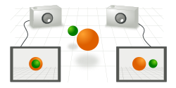
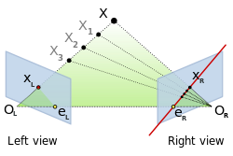
3.1 Camera Motion Estimation
Relative camera motion between two consecutive frames is estimated using the epipolar constraint.
Algorithm synthesizes motion effects for viewers, not to reconstruct physically-exact camera motion.
Easily implementable and widely applicable. Two steps:
1. Identifying Corresponding Points
2. Computing Robust Camera Motion Parameters

Slide 3
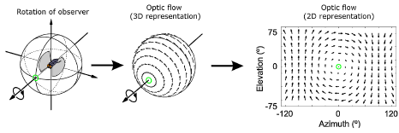

3.1.1 Identifying Corresponding Points
Employ optical flow to obtain correspondence points between two frames because it typically leads to a better estimation of the fundamental matrix than sparse matching algorithms.
More specifically, employ a variational optical flow estimation algorithm based on an anisotropic (i.e. image-driven) Huber-L¹ optical flow regularization (Werlberger et al., 2009).

Slide 4
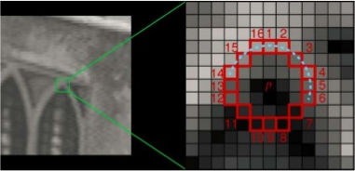
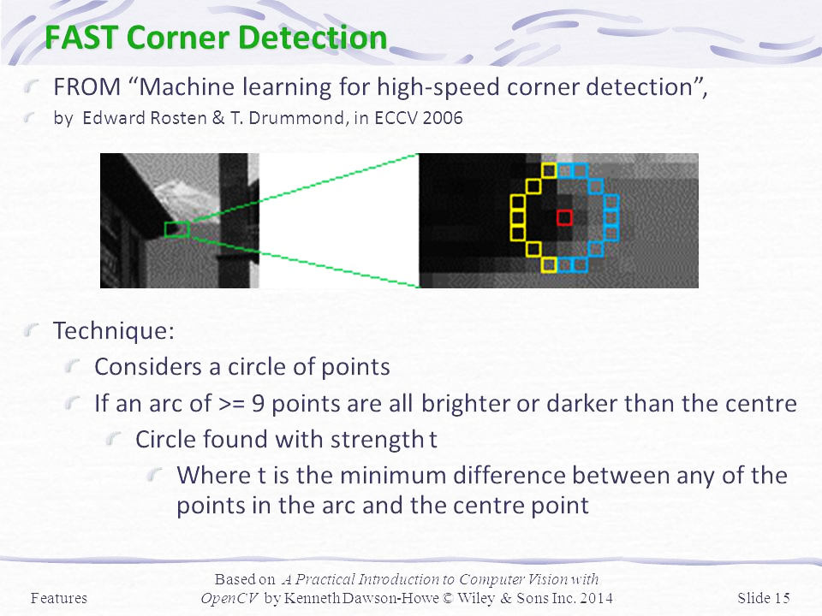
3.1.1 Identifying Corresponding Points (cont.)
Optical flow estimation can be unreliable in smooth and textureless areas (e.g., sky or road), therefore the authors select only corner points, extracted by FAST.
FAST classifies a point as a corner if the point is brighter or darker than the majority of its neighborhood pixels by a certain threshold.

Slide 5
3.1.2 Computing Robust Camera Motion Parameters
Once the correspondence points between frames are obtained, the fundamental matrix is estimated by RANSAC combined with the normalized 8-point algorithm.
The goal is to restore camera motion, from which we can determine the relative geometric configuration and consequently compute camera motion parameters: Angular Velocity, Linear Velocity, and Linear Acceleration.
These variables are used for the synthesis of CF and CS effects.

Slide 6
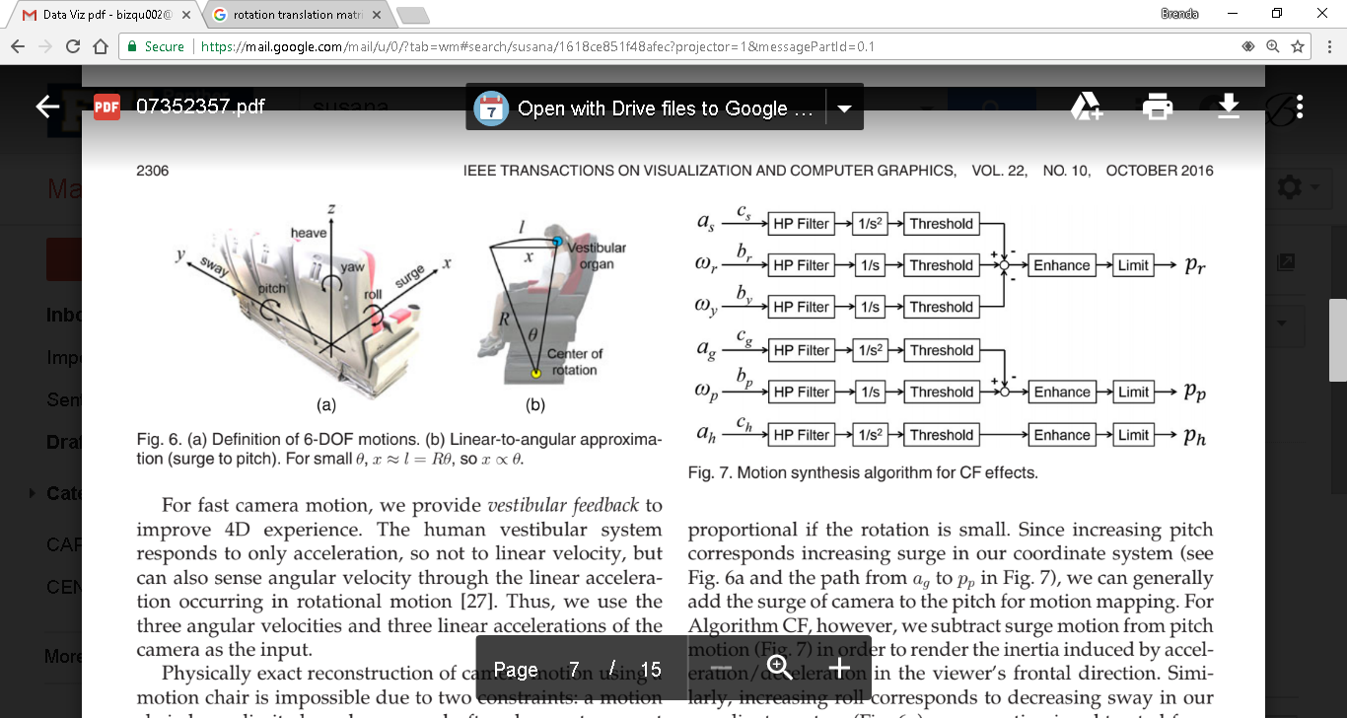
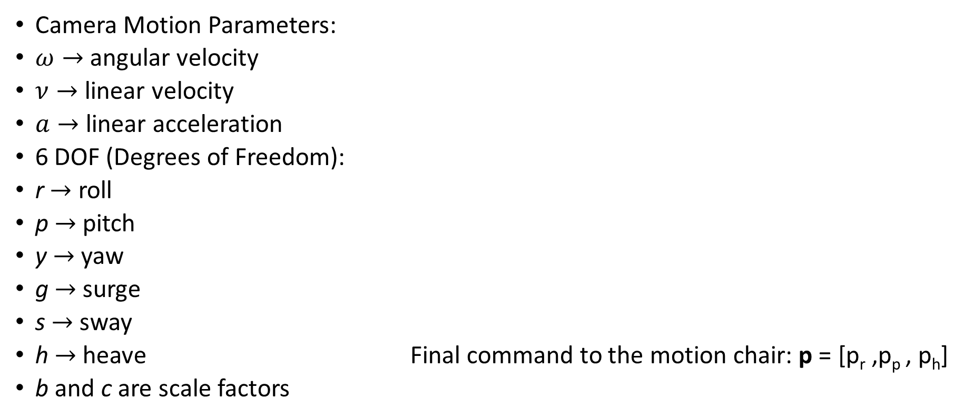
3.2 Synthesis of Fast Camera Motion Effects
Camera Motion Parameters:
$ω→$ angular velocity
$ν→$ linear velocity
$a→$ linear acceleration
6 DOF (Degrees of Freedom):
r $→$ roll
p $→$ pitch
y $→$yaw
g $→$ surge
s $→$ sway
h $→$ heave Final command to the motion chair: p = [p_{r} ,p_{p} , p_{h}]
b and c are scale factors

Slide 7
3.2 Synthesis of Fast Camera Motion Effects (cont.)
Use a high-pass filter
Render the inertia induced by acceleration or deceleration
Apply soft thresholding
Enhance the combined motion commands to obtain dynamic effects
Limit the commands not to exceed the maximum displacement and velocity of the motion chair
Final command to the motion chair: p = [p_{r} ,p_{p} , p_{h}]

Slide 8
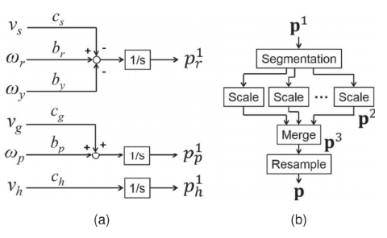
3.3 Synthesis of Slow Camera Motion Effects
Recreate slow camera motion using a motion chair.
2 phases:
(a) Motion mapping and conversion
(b) Segmentation and scaling
Algorithm CF can also provide slowly moving sensations for slow camera motion. But Algorithm CS synthesizes fundamentally different motion effects.

Slide 9
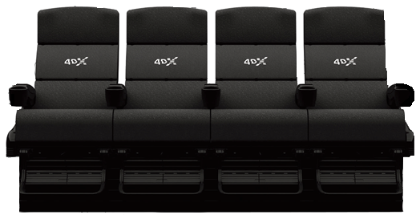
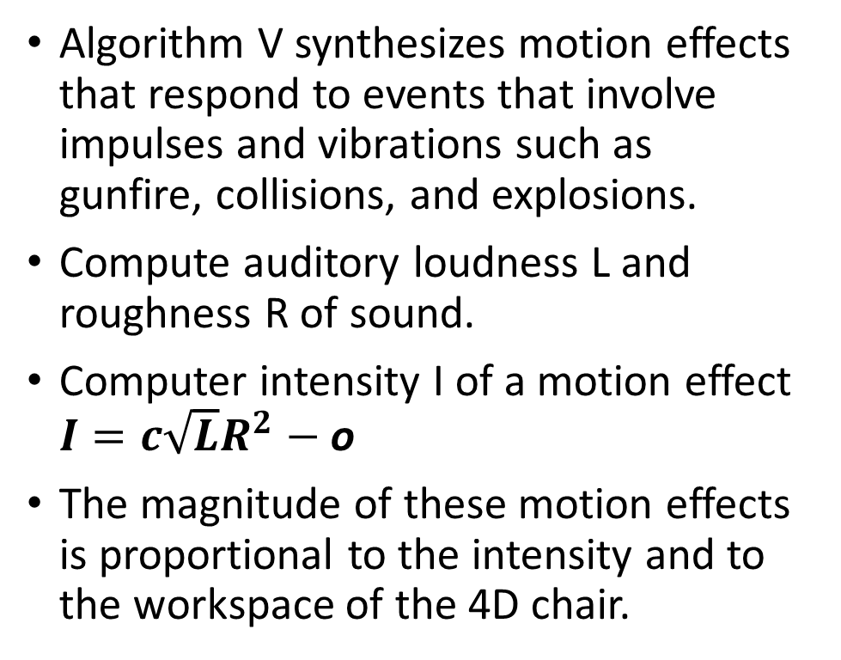
3.4 Synthesis of Impulse and Vibration Effects
Algorithm V synthesizes motion effects that respond to events that involve impulses and vibrations such as gunfire, collisions, and explosions.
Compute auditory loudness L and roughness R of sound.
Computer intensity I of a motion effect $I=c\sqrt{L}R^{2}$ $−$ o
The magnitude of these motion effects is proportional to the intensity and to the workspace of the 4D chair.

